Slide 1
Eve Zhang & Carlos Gimeno
In all, 2111 individuals from China responded to the question on journal selection difficulty.
The results are not very different for China: 64% respondents found journal selection moderately to extremely difficult. Below is the exact break-up:
Notes:
IFIS have developed a journal recommendation service especially for researchers in food science & technology.
We have developed this service because research indicates that many researchers find journal selection difficult.

Slide 2
Journal Recommendation Service （期刊推荐服务）
Especially for
Researchers in food science & technology
（特别为食品科学与技术领域的研究人员而制作）
In all, 2111 individuals from China responded to the question on journal selection difficulty.
The results are not very different for China: 64% respondents found journal selection moderately to extremely difficult. Below is the exact break-up:
Notes:
IFIS have developed a journal recommendation service especially for researchers in food science & technology.
We have developed this service because research indicates that many researchers find journal selection difficult.

Slide 3
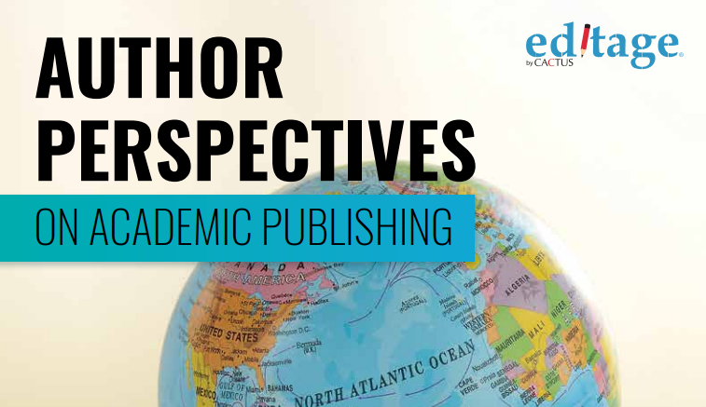
Journal Recommendation Service （期刊推荐服务）
64%
of researchers from China
Said they found journal selection
moderately to extremely difficult (64%来自中国的研究人员说他们发现期刊选择中度至极度困难)
n. 2111
In all, 2111 individuals from China responded to the question on journal selection difficulty.
The results are not very different for China: 64% respondents found journal selection moderately to extremely difficult. Below is the exact break-up:
Notes:
An international survey by Editage found that 2/3rds of researchers from China who responded said they found the process difficult.
This number is similar to the global average.
So, we have developed the journal recommendation service as solution to the problem.
64%的中国研究人员说他们发现选择期刊对他们来说是中等到极端困难。

Slide 4
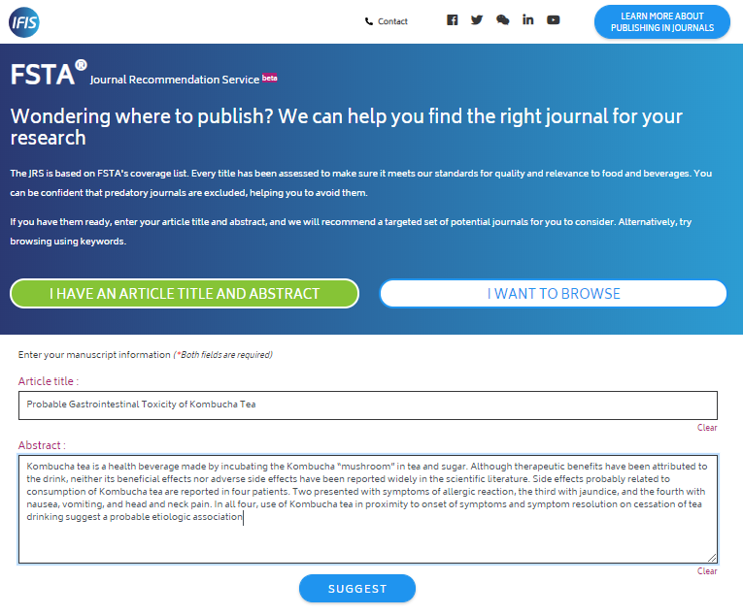
The Journal Recommendation Service makes it easy to
identify
the best journals
to send manuscripts to . . .
(JRS期刊推荐服务让识别您的最佳投稿目标期刊变得容易)
Step 1 search by keyword, title or abstract
(第一步：检索关键字、题名或摘要)
Notes:
The JRS makes it easy to identify the best journals to send manuscripts to. Using the tool you can complete the process in 3 easy steps.
This is the home page. Step 1 involves entering either key words or a title or an abstract. Obviously the more information you add the better the results.
Clicking “suggest” leads you to the results page . . . .
JRS期刊推荐服务让识别您的最佳投稿目标期刊变得容易
第一步：检索关键字、题名或摘要

Slide 5
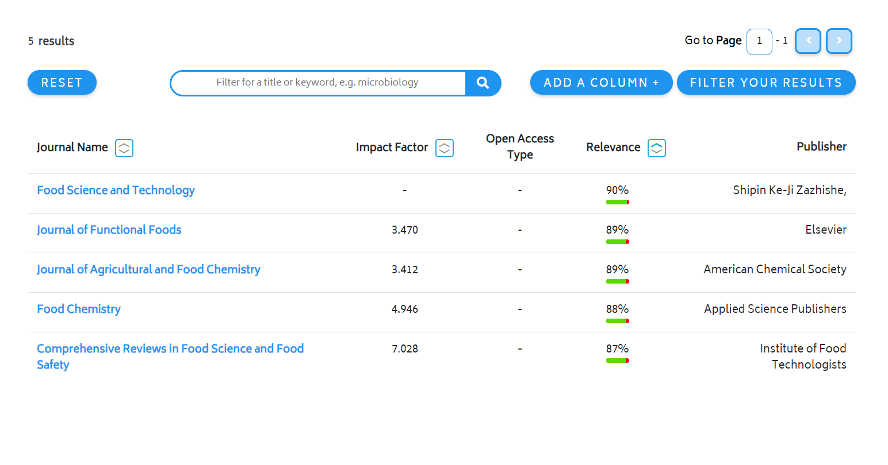
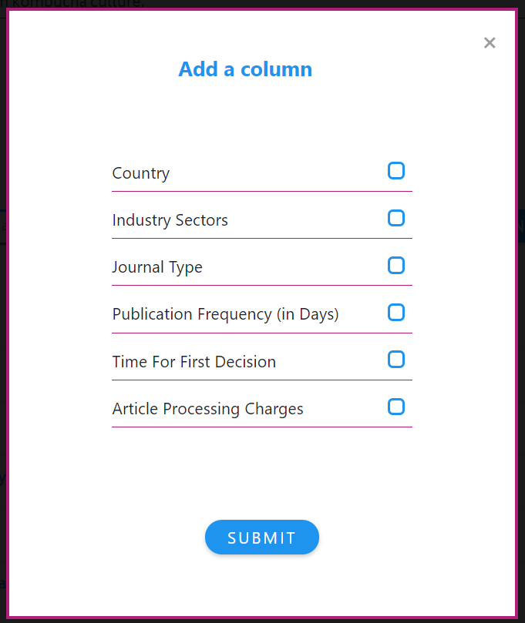
JRS makes it easy to identify the best journals to send manuscripts to . . .
Step 2 select journals by preferred criteria
(第二步：按您希望的条件（标准）选择期刊)
Notes:
On the results page you will see a list of suggested journals. There is plenty of relevant information to help you choose. You can see the journals impact factor, whether it is OA or not and who publishes it.
We also include a relevance ranking. More on this later.
Furthermore, you can customise the results page to include additional information about each journal. The box on the right shows you those options. They include such things as publication frequency and article publishing charges (APCs).
第二步：按您希望的条件（标准）选择期刊

Slide 6
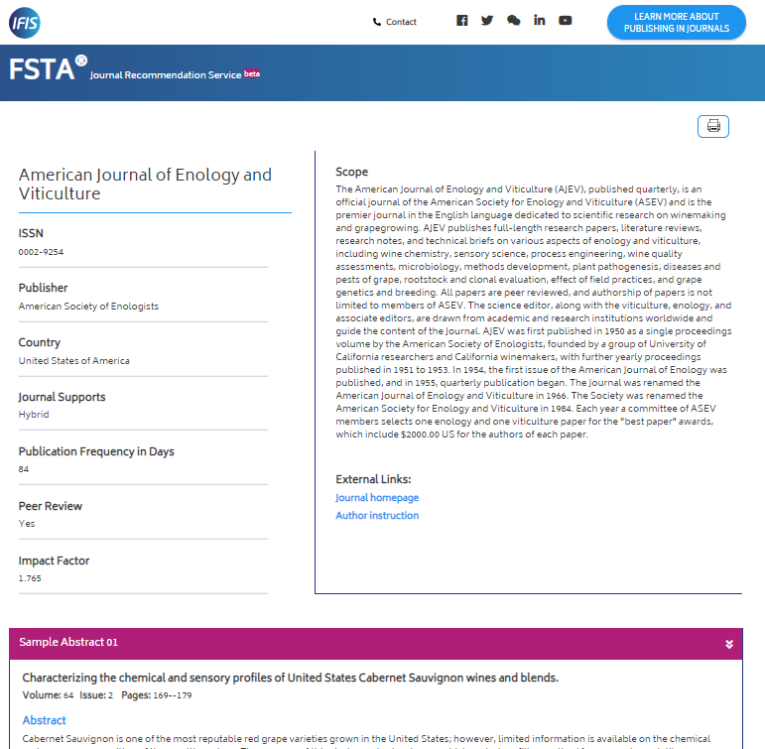
Step 3
learn more about the journal . . .
(第三步：更多地了解您想选择的
那本期刊)
Notes:
Step 3 takes you to the journal information page. This enables you to check that the journal you have selected is the best one. It contains more detail about the journal including its scope and sample abstracts.
If you decide that it is the right journal, you can click through to the journal submission page and thus complete the process.
第三步：更多地了解您想选择的期刊

Slide 7
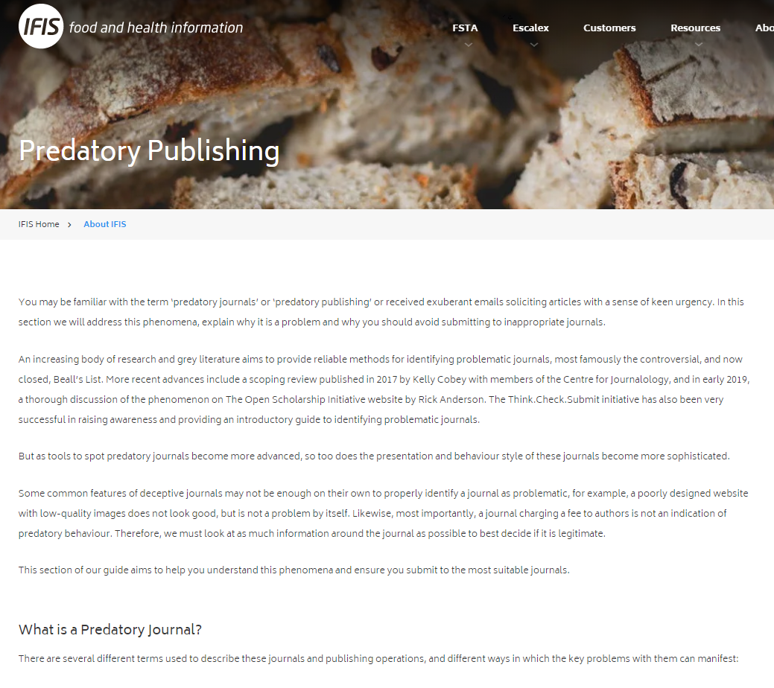
JRS makes it easy to identify the best journals to send manuscripts to . . .
Learn more about
journal selection
（更多了解您想
选择的期刊)
Guide
written by Duncan Nicolas, Vice President, European Association of Science Editors
（指南：由欧洲科学编辑协会副主席Duncan Nicolas撰写）
Notes:
If you are unfamiliar with the journal publishing process you can also access our introductory guidance.
This can be accessed by clicking on the link on the home page.
This has been written by Duncan Nicholas, the VP of the European Assoc of Science Editors. It includes sections on : open access etc
掠夺式出版
指南：由欧洲科学编辑协会副主席Duncan Nicolas撰写

Slide 8
How does the Journal Recommendation Service work?（JRS是如何工作的（如何帮您推荐期刊的）？
All journals have been selected by food science experts
（所有期刊都是由食品科学专家选出的）
IFIS employ 8 experts with a food science background
（IFIS雇佣了8名具有食品科学专业背景的专家）
They are supported by an advisory board of leading food science practitioners
（他们由顶尖食品科学从业者组成的咨询委员会提供支持）
They evaluate each journal using a detailed set of criteria
（专家们使用一套详细的标准来评估每本杂志）
Notes:
I am now going to explain briefly how the JRS works and why it is the best tool you can use to get journal recommendations
They key elements (1) we employ food science experts to manage the data and (2) we use machine learning algorithms to search it.
Firstly, all of the journals have been vetted by food science experts.
We employ 8 experts with a food science background and they are supported by an advisory board of leading food science practitioners (there’s more information about the group on our website)
Each journal is evaluated using a comprehensive list of criteria
This means you are GUARANTEED to avoid predatory OA journals
JRS是如何工作的（如何帮您推荐期刊的）？
所有期刊都是由食品科学专家选出的
IFIS雇佣了8名具有食品科学专业背景的专家
他们由顶尖食品科学从业者组成的咨询委员会提供支持
专家们使用一套详细的标准来评估每本杂志
在2018年，这个专家团队 1. 识别出16种掠夺式期刊；2 他们收到并拒绝了49个掠夺式期刊要求
（收录他们的期刊进FSTA）的申请（49/106）

Slide 9
How does the Journal Recommendation Service work（JRS是如何工作的（如何帮您推荐期刊的）？
In 2018 the team . . .
identified 16 predatory publishers
received & rejected applications from 49 predatory journals (49/106)
（在2018年，这个专家团队 1. 识别出16种
掠夺式期刊；2. 他们收到并拒绝了49个掠夺式期刊要求（接受他们的期刊进FSTA）的申请（49/106) ）
Notes:
You are probably aware that predatory OA journals are journals that claim to conduct peer reviews BUT don’t. So, they effectively publish fake science.
Journal publishers want to be included in our database because they know that it is used leading food science departments around the world. So, we receive many applications each year.
Last year we rejected 49 out of 106 applications because the journals were predatory. So, that gives you a sense of the scale of the problem.
JRS是如何工作的（如何帮您推荐期刊的）？
所有期刊都是由食品科学专家选出的
IFIS雇佣了8名具有食品科学专业背景的专家
他们由顶尖食品科学从业者组成的咨询委员会提供支持
专家们使用一套详细的标准来评估每本杂志
在2018年，这个专家团队 1. 识别出16种掠夺式期刊；2 他们收到并拒绝了49个掠夺式期刊要求
（收录他们的期刊进FSTA）的申请（49/106）

Slide 10
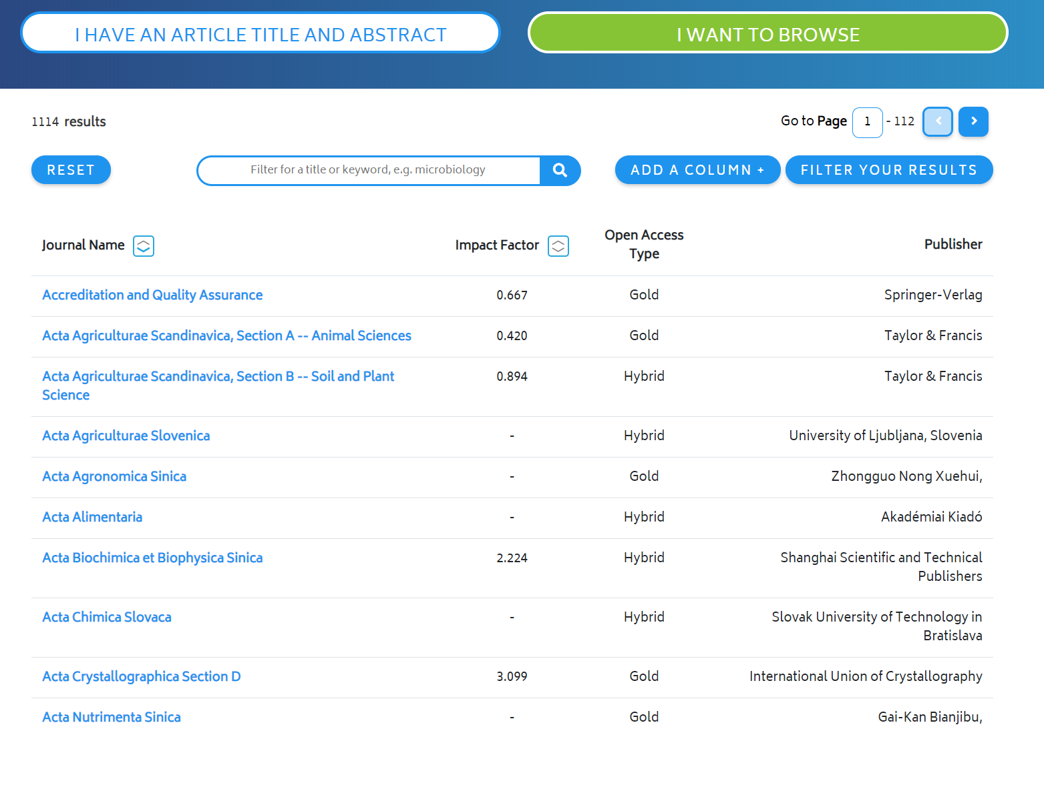
You can browse the “white list” of 1,100+
food science journals . . .
（你可以在1200种食品科学期刊的“白名单”里浏览）
Notes:
There is another feature of the JRS which you may find useful. This is the option to search through the database of journals.
This database is the most comprehensive database of legitimate food science journals available. It contains over 1,100 titles.
你可以在1200种食品科学期刊的“白名单”里浏览

Slide 11
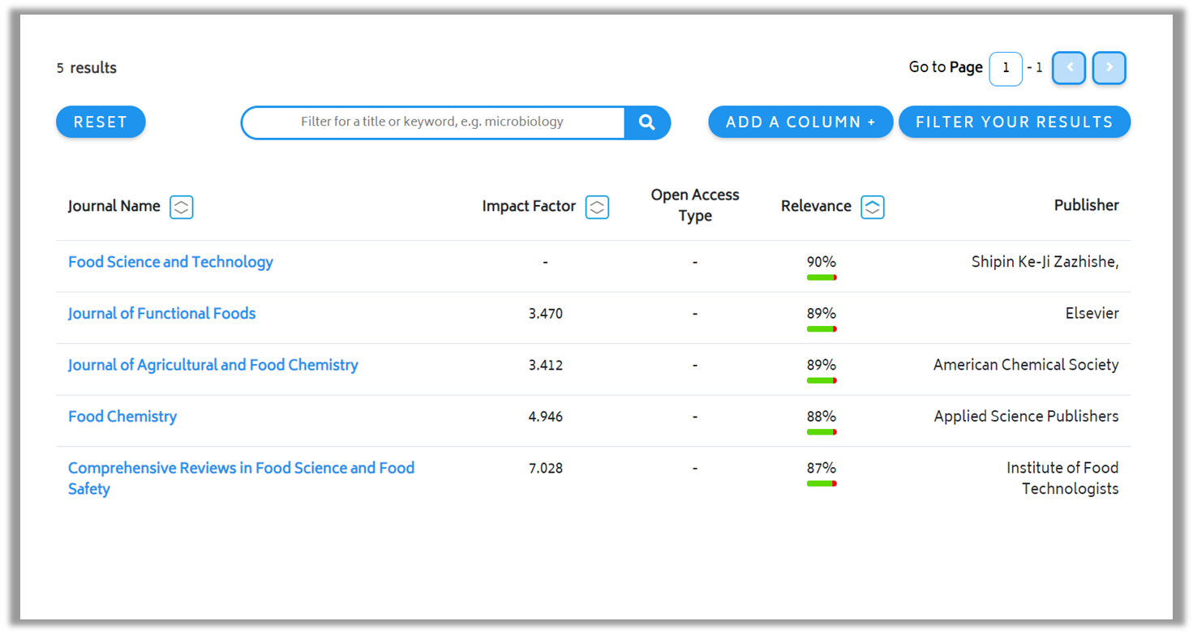
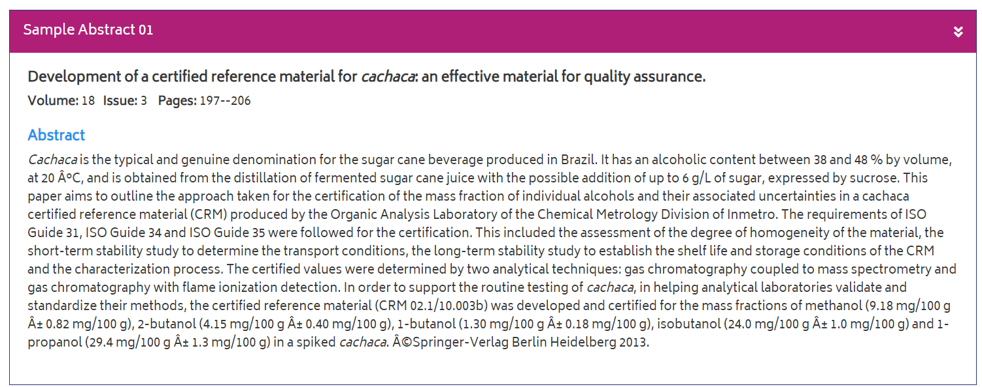
How does the Journal Recommendation Service work（期刊推荐服务JRS是如何工作的）?
2. Search algorithm scans articles actually selected by journal editors（检索算法会从期刊编辑们选出的期刊中进行文章扫描）
Notes:
I pointed out that your search results will include a “relevance” ranking.
This is generated by a machine learning algorithm. It searches all of the abstracts in the database and identifies which are most similar and matches those with particular journals. This means that you have a clearer view of what journal editors are actually selecting, rather than relying on the journal’s scope, which may be out of date or unclear.
So, in summary, the combination of food scientists and clever algorithms ensure that you identify the best journal to send your manuscript to.
基于文章标题和摘要分析的机器学习算法,从合格期刊的FSTA数据库中分析了成千上万的摘要。它将您输入的摘要和标题与所分析和存储的内容进行比较。然后它创建一个匹配最紧密的摘要列表,并查看它们来自哪些期刊。这将产生一份“推荐”期刊的列表,这些期刊之前发表过与用户所输入的摘要和标题相类似的文章。

Slide 12
How to access the Journal Recommendation Service . . .
（如何访问JRS期刊推荐服务）
Available free to subscribers to FSTA
（对于FSTA数据库的用户免费）
（或在此扫描我们的二维码）
Notes:
如何访问JRS期刊推荐服务？
对于FSTA数据库的用户免费
Beta版：对CIFST的参会代表给与免费试用三个月的福利
明天上午到我们在大会门口的展位（请寻找有IFISlogo的背板）来看一看；明天下午到14日下午，
我们的展台在三楼分会场门口
或者 给我发邮件 或\在此扫描我们的二维码

